Slide 1

Improvi
Go, change the world
RV College of
Engineering
Unit 3 (Relational Database Design)
Original Content: Ramez Elmasri and Shamkant B. Navathe
Dr. Shobha G
Professor, Department of CSE
RV College of Engineering, Bengaluru - 59

Slide 2

Contents
Go, change the world
RV College of
Engineering
1 Functional Dependencies (FDs)
1.1 Definition of FD
1.2 Inference Rules for FDs
1.3 Equivalence of Sets of FDs
2 Normal Forms Based on Primary Keys
2.1 Introduction to Normalization
2.2 First Normal Form
2.3 Second Normal Form
2.4 Third Normal Form
3 General Normal Form Definitions (For Multiple Keys)
4 BCNF (Boyce-Codd Normal Form)

Slide 3
Functional Dependencies
Go, change the world
RV College of
Engineering
Functional dependencies (FDs) are used to specify formal measures of the "goodness" of relational designs
FDs and keys are used to define normal forms for relations
FDs are constraints that are derived from the meaning and interrelationships of the data attributes
FD is a constraint between two sets of attributes
A set of attributes X functionally determines a set of attributes Y if the value of X determines a unique value for Y

Slide 4
Functional Dependencies
Go, change the world
RV College of
Engineering
X → Y holds if whenever two tuples have the same value for X, they must have the same value for Y
For any two tuples t1 and t2 in any relation instance r(R):
If t1[X]=t2[X],
then t1[Y]=t2[Y]
X → Y in R specifies a constraint on all relation instances r(R)
Written as X → Y; can be displayed graphically on a relation schema as in Figures. ( denoted by the arrow: ).
FDs are derived from the real-world constraints on the attributes

Slide 5
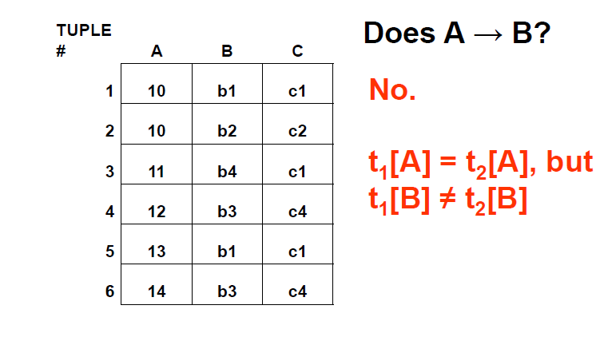
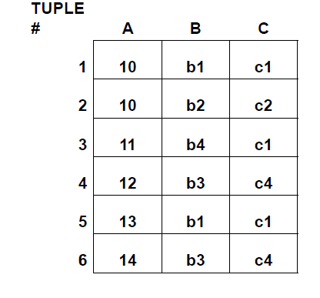
Example
Go, change the world
RV College of
Engineering
_{Does B→C}

Slide 6
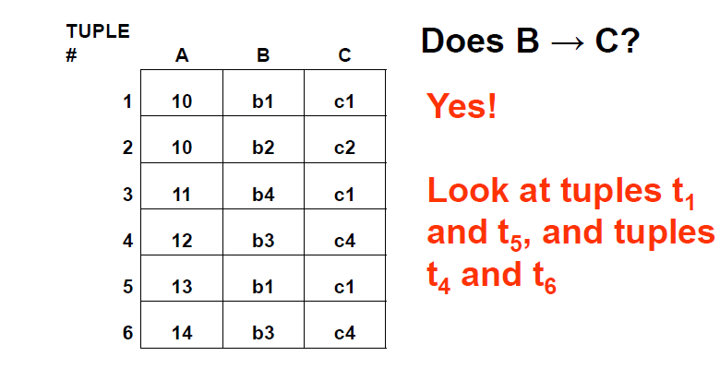
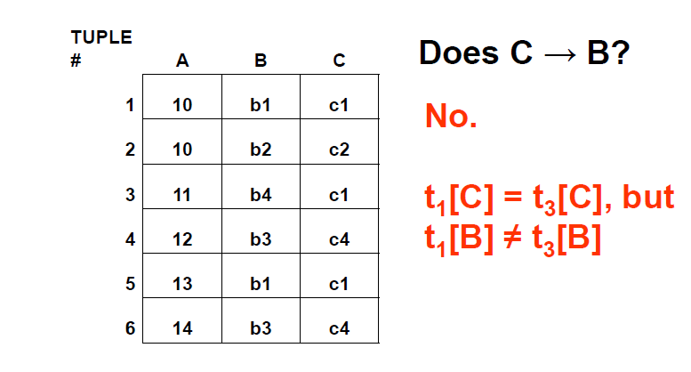
Examples of FD constraints
Go, change the world
RV College of
Engineering

Slide 7
Examples of FD constraints
Go, change the world
RV College of
Engineering
social security number determines employee name
SSN -> ENAME
project number determines project name and location
PNUMBER -> {PNAME, PLOCATION}
employee ssn and project number determines the hours per week that the employee works on the project
{SSN, PNUMBER} -> HOURS

Slide 8
Examples of FD constraints
Go, change the world
RV College of
Engineering
An FD is a property of the attributes in the schema R
The constraint must hold on every relation instance r(R)
If K is a key of R, then K functionally determines all attributes in R (since we never have two distinct tuples with t1[K]=t2[K])
FDs must hold for all valid states of a relation, not just current state
So define FDs carefully!

Slide 9
Go, change the world
RV College of
Engineering
How do we identify FDs?
Likely, some FDs will be obvious or identified in initial design of DB
Vehicle(tagno, regstate, owner, make, model, year, gaseconomy, dealership, dealeraddr)
{tagno, regstate} → owner
{tagno, regstate} → {make, model, year}
{make, model, year} → gaseconomy,
dealership → dealeraddr etc…

Slide 10
Inferring FDs
Go, change the world
RV College of
Engineering
Ex: (SSN, PNUMBER, HOURS, ENAME, PNAME, PLOCATION)
SSN → ENAME,
{SSN, PNUMBER} → HOURS, PNUMBER → PNAME, PNUMBER → PLOCATION
PNUMBER → PNAME,
so {PNUMBER, HOURS} → PNAME
PNUMBER → PNAME and PNUMBER → PLOCATION, so PNUMBER → {PNAME, PLOCATION}
25

Slide 11
Inference Rules for FDs
Go, change the world
RV College of
Engineering
Given a set of FDs F, we can infer additional FDs that hold whenever the FDs in F hold
Armstrong's inference rules:
IR1. (Reflexive) If Y subset-of X, then X -> Y
IR2. (Augmentation) If X -> Y, then XZ -> YZ
(Notation: XZ stands for X U Z)
IR3. (Transitive) If X -> Y and Y -> Z, then X -> Z
IR1, IR2, IR3 form a sound and complete set of inference rules

Slide 12
Inference Rules for FDs
Go, change the world
RV College of
Engineering
Some additional inference rules that are useful:
(Decomposition) If X -> YZ, then X -> Y and X -> Z
(Union) If X -> Y and X -> Z, then X -> YZ
(Psuedotransitivity) If X -> Y and WY -> Z, then WX -> Z
The last three inference rules, as well as any other inference rules, can be deduced from IR1, IR2, and IR3 (completeness property)

Slide 13
Inference Rules for FDs
Go, change the world
RV College of
Engineering
Closure of a set F of FDs is the set F⁺ of all FDs that can be inferred from F
Closure of a set of attributes X with respect to F is the set X ⁺ of all attributes that are functionally determined by X
X ⁺ can be calculated by repeatedly applying IR1, IR2, IR3 using the FDs in F

Slide 14
Closure of X under F (X⁺)
Go, change the world
RV College of
Engineering
X⁺ = set of all attributes dependent on X
Algorithm
start with X⁺ = X
for each FD Y → Z in F do
if Y is a subset of X⁺ then X⁺ = X⁺ U Z
Continue this process until no more attributes can be added to X⁺

Slide 15
Example
Go, change the world
RV College of
Engineering
Given a relation Student and a set of functional dependencies F as follows, compute the closure for all LHS.
Student(SID, dept, dept_chair)
F = { SID → {dept, dept_chair}, dept → dept_chair,
{SID, dept} → dept_chair }
{SID}⁺ = {SID, dept, dept_chair}
{dept}⁺ = {dept, dept_chair}
{SID, dept} ⁺ = {SID, dept, dept_chair}
If the closure of a LHS includes all attributes, then this LHS is a super key of the relation.

Slide 16
Candidate Keys
Go, change the world
RV College of
Engineering
If X⁺ contains all attributes in a relation R, and if there does not exist Y in X
such that (X – Y)⁺ = all attributes in R, then X is a candidate key for R
In previous example, {SID,dept}⁺ includes all attributes, SID⁺ also includes all attributes.
SID is a candidate key

Slide 17
Exercise
Go, change the world
RV College of
Engineering
R(A,B,C,D,G,H)
F = { A → B, B → C, CD → H, BC →G}
What is the closure of AC?

Slide 18
Equivalence of Sets of FDs
Go, change the world
RV College of
Engineering
Two sets of FDs F and G are equivalent if:
- every FD in F can be inferred from G, and
- every FD in G can be inferred from F
Hence, F and G are equivalent if F ⁺ =G ⁺
Definition: F covers G if every FD in G can be inferred from F (i.e., if G ⁺ subset-of F ⁺)
F and G are equivalent if F covers G and G covers F
There is an algorithm for checking equivalence of sets of FDs

Slide 19
Go, change the world
RV College of
Engineering
Example of Equivalent FD sets
F1 = { SID → {dept, dept_chair}, dept → dept_chair,
{SID, dept} → dept_chair }
F2 = { SID → {dept, dept_chair}, dept → dept_chair}
F1 covers F2
Only need to check if F2 can also infer F1
i.e. Can we generate the set of FDs in F1 using FDs defined in F2?
Compute {SID,dept}⁺ based on F2
Its closure includes all attributes
We can conclude that {SID,dept} → dept_chair

Slide 20
Minimal Sets of FDs
Go, change the world
RV College of
Engineering
A set of FDs is minimal if it satisfies the following conditions:
Every dependency in F has a single attribute for its RHS.
We cannot remove any dependency from F and have a set of dependencies that is equivalent to F.
We cannot replace any dependency X -> A in F with a dependency Y -> A, where Y proper-subset-of X ( Y subset-of X) and still have a set of dependencies that is equivalent to F.

Slide 21
Minimal Sets of FDs
Go, change the world
RV College of
Engineering
Every set of FDs has an equivalent minimal set
There can be several equivalent minimal sets
There is no simple algorithm for computing a minimal set of FDs that is equivalent to a set F of FDs

Slide 22
Algorithm
Go, change the world
RV College of
Engineering
Given a set of FDs F, find its minimal cover
Step1: Decompose each FD to get single attribute at RHS
Step2: For each FD, remove redundant attribute from LHS
Step3: Remove redundant FDs

Slide 23
Example
Go, change the world
RV College of
Engineering
Given F= {B → AB, D → A, AB → D}
Step 1: B → AB is decomposed into B → A, B → B
(B → B is trivial and is removed)
Step 2: check if AB → D has redundant LHS. Can it be A → D or B → D?
Compute AB⁺, A⁺, B⁺ based on F
AB⁺ = ABD and B⁺ = ABD, so A is extraneous.
So far, we have F= {B → A, D → A, B → D}

Slide 24
Example (cont.)
Go, change the world
RV College of
Engineering
So far, we have F= {B → A, D → A, B → D}
Step 3: check if there is any redundant FDs. Is B → A redundant?
Compute B⁺ based on F- {B → A}
B⁺ = BDA, that means we can obtain
B → A from F- {B → A} so B → A is redundant.
Similarly, check the remaining FDs.
Final answer F’ = {D → A, B → D}

Slide 25
Exercise
Go, change the world
RV College of
Engineering
Given a set of FDs F, find its minimal cover
Step1: Decompose each FD to get single attribute at RHS
Step2: For each FD, remove redundant attribute from LHS
Step3: Remove redundant FDs
Question: what is the minimal cover of F?
R(A, B, C), F = {A → B, BC → A, AB → AC}

Slide 26
Minimal Set (Cover) of FDs
Go, change the world
RV College of
Engineering
There can be more than one minimal cover for a relation
They won’t necessarily have the same number of FDs

Slide 27
Normalization of Relations
Go, change the world
RV College of
Engineering
Normalization: The process of decomposing unsatisfactory "bad" relations by breaking up their attributes into smaller relations
Normal form: Condition using keys and FDs of a relation to certify whether a relation schema is in a particular normal form

Slide 28
Normalization of Relations
Go, change the world
RV College of
Engineering
2NF, 3NF, BCNF
based on keys and FDs of a relation schema
4NF
based on keys, multi-valued dependencies : MVDs; 5NF based on keys,
Join dependencies : JDs (Chapter 11)
Additional properties may be needed to ensure a good relational design (lossless join, dependency preservation; Chapter 11)

Slide 29
Practical Use of Normal Forms
Go, change the world
RV College of
Engineering
Normalization is carried out in practice so that the resulting designs are of high quality and meet the desirable properties
The practical utility of these normal forms is questionable when the constraints on which they are based are hard to understand or to detect
The database designers need not normalize to the highest possible normal form
(usually up to 3NF, BCNF or 4NF)
Denormalization:
The process of storing the join of higher normal form relations as a base relation—which is in a lower normal form

Slide 30
Definitions of Keys and Attributes Participating in Keys
Go, change the world
RV College of
Engineering
A superkey of a relation schema R = {A1, A2, ...., An} is a set of attributes S subset-of R with the property that no two tuples t1 and t2 in any legal relation state r of R will have t1[S] = t2[S]
A key K is a superkey with the additional property that removal of any attribute from K will cause K not to be a superkey any more.

Slide 31
Definitions of Keys and Attributes Participating in Keys
Go, change the world
RV College of
Engineering
If a relation schema has more than one key, each is called a candidate key.
One of the candidate keys is arbitrarily designated to be the primary key, and the others are called secondary keys.
A Prime attribute must be a member of some candidate key
A Nonprime attribute is not a prime attribute—that is, it is not a member of any candidate key.

Slide 32
First Normal Form 1NF
Go, change the world
RV College of
Engineering
A relation scheme R is in first normal form (1NF) if the values in dom (A) are atomic for every attribute A in R.
Disallows
composite attributes
Set-valued attributes
nested relations; a cell of an individual tuple is a complex relation

Slide 33
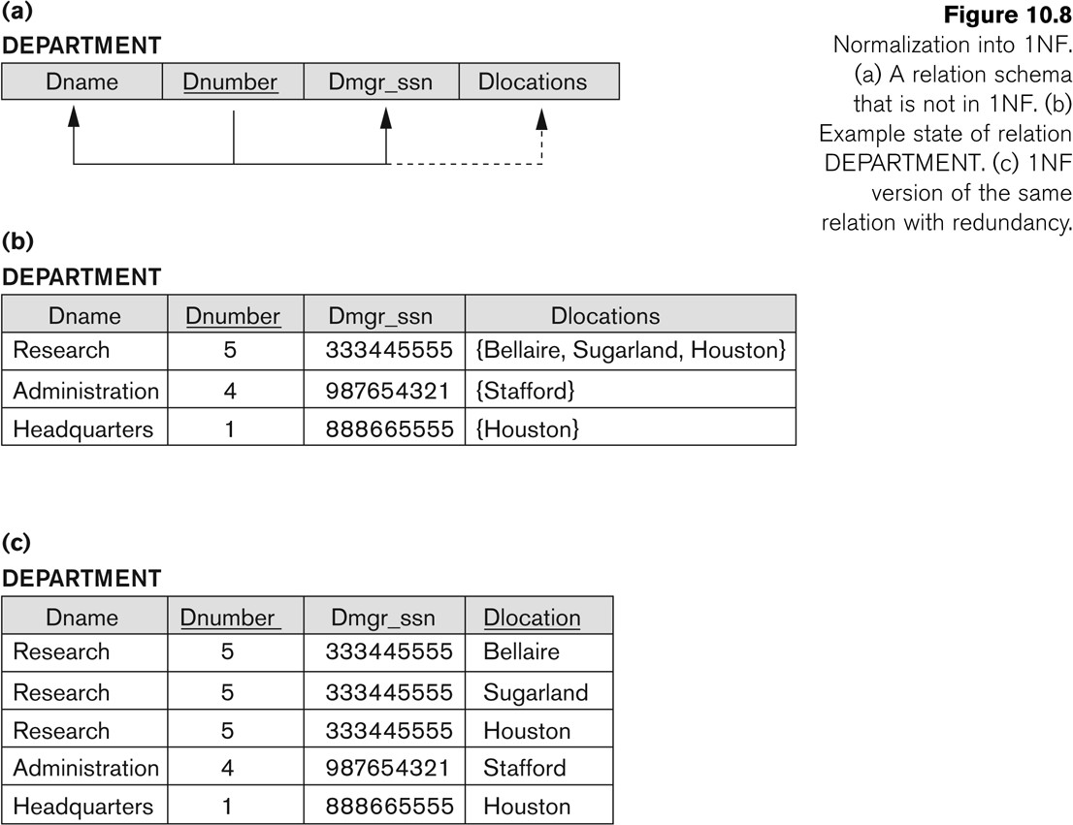
First Normal Form 1NF
Go, change the world
RV College of
Engineering

Slide 34
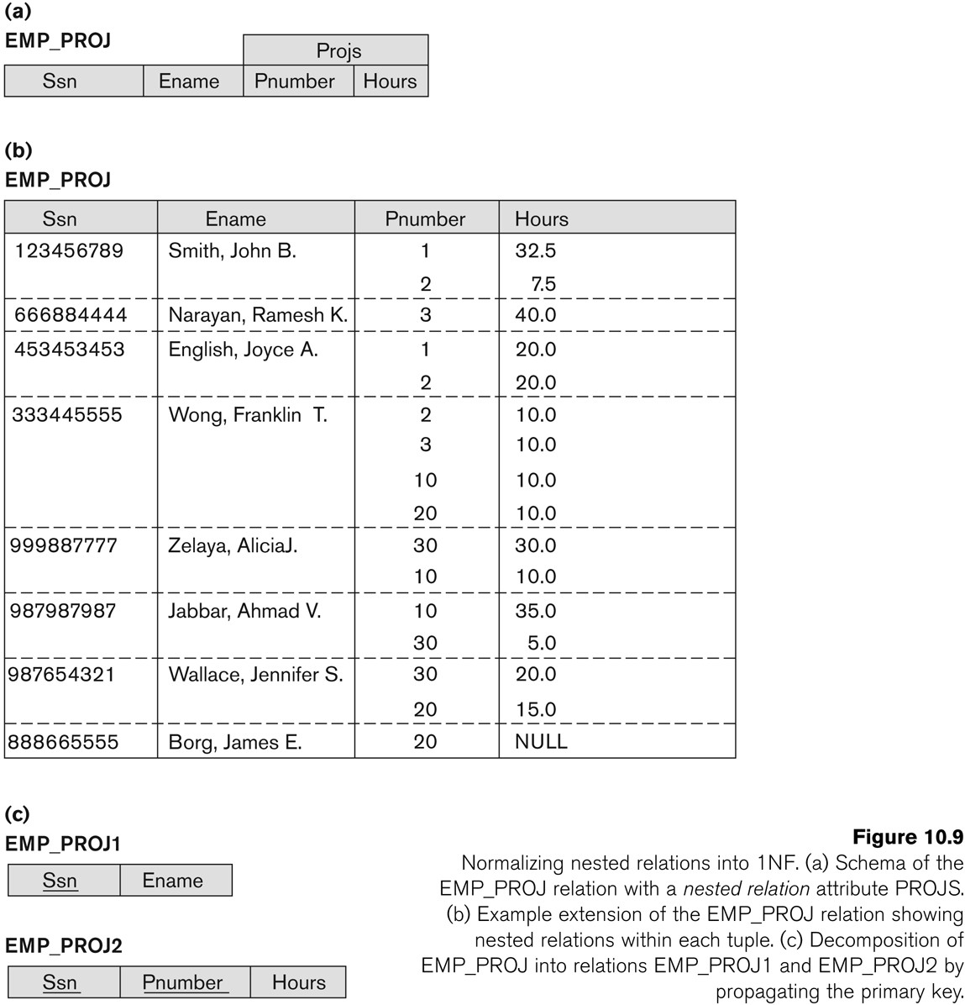
Normalization nested relations into 1NF
Go, change the world
RV College of
Engineering
Composite attributes

Slide 35
Second Normal Form
Go, change the world
RV College of
Engineering
Uses the concepts of FDs, primary key
Definitions
Prime attribute: An attribute that is member of the primary key K
Left-Reduced or Full functional dependency: a FD Y → Z where removal of any attribute from Y means the FD does not hold any more
Examples:
{SSN, PNUMBER} → HOURS is a full FD since neither SSN  HOURS nor PNUMBER → HOURS hold
{SSN, PNUMBER} → ENAME is not a full FD (it is called a partial dependency ) since SSN →ENAME also holds

Slide 36
Second Normal Form
Go, change the world
RV College of
Engineering
A relation scheme R is in second normal form (2NF) with respect to a set of FDs F if it is in 1NF and every nonprime attribute is fully dependent on every key of R.
R can be decomposed into 2NF relations via the process of 2NF normalization
Example
Let R=ABCD and F = { AB → C, B → D }. Here AB is a key. C and D are non-prime. C is fully dependent on the entire key AB, however D functionally depends on just part of the key (B →D). This is called a partial dependency

Slide 37
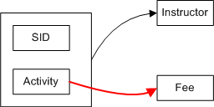
Second Normal Form
Go, change the world
RV College of
Engineering
Example
We deduce from the data sample
activity →fee,
sid activity →instructor
Key: {sid ,activity}. Non-key attributes: { Fee, Instructor }
There is a partial dependency therefore the schema is not 2NF
SID | Activity | Fee | Instructor
100 | Basket Ball | 200 | Lebron
100 | Golf | 65 | Arnold
200 | Golf | 65 | Jack
300 | Golf | 65 | Lebron

Slide 38
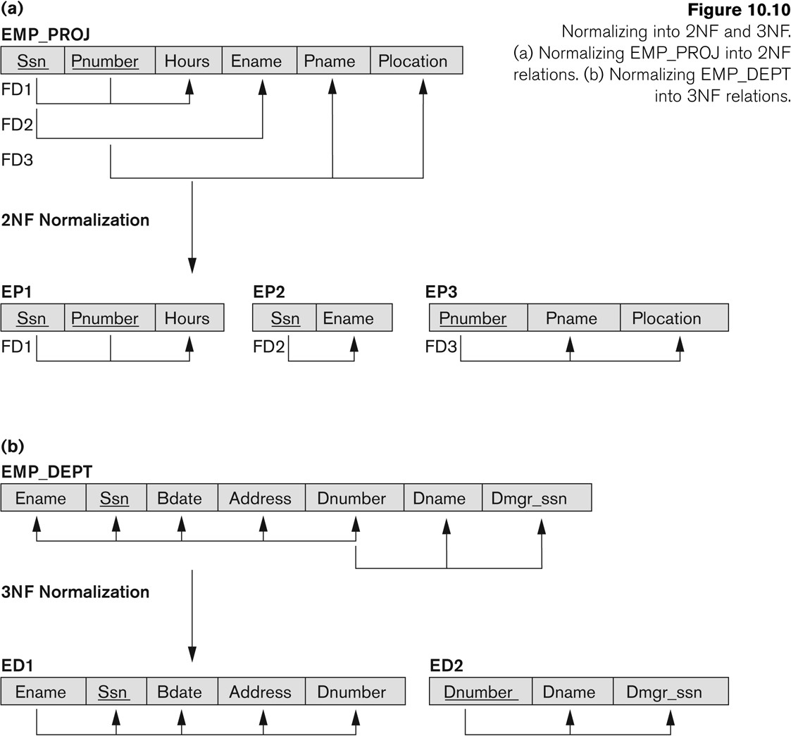
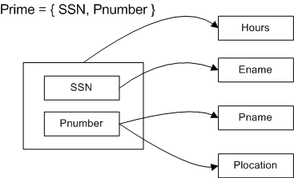
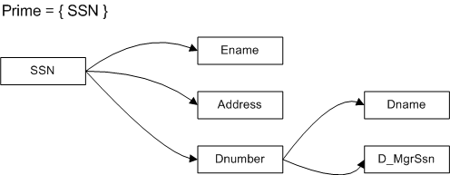
Normalizing into 2NF and 3NF
Go, change the world
RV College of
Engineering

Slide 39
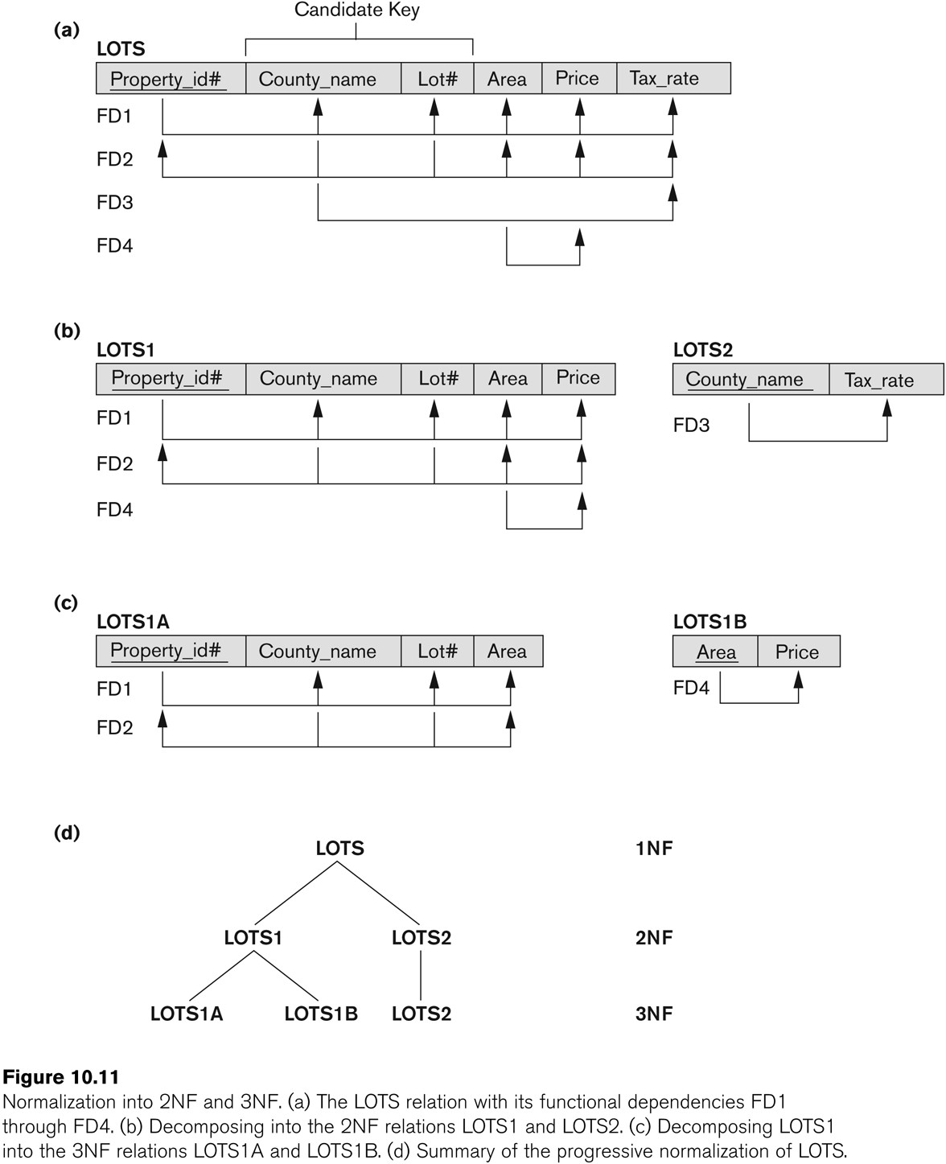
Normalization into 2NF and 3NF
Go, change the world
RV College of
Engineering

Slide 40

Third Normal Form
Go, change the world
RV College of
Engineering
Definition:
Given a relation scheme R, a subset X of R, an attribute A in R, and a set of FDs F, A is transitively dependent upon X in R if there is a subset Y of R with:
X →Y, Y→X and Y → A under F and AϵXY.
Examples:
Schema (ABCD) and F = {A →B, B →AC, C →D }
D is transitively dependent on A(and B) via C, however C is not transitively dependent on A via B (B is prime).

Slide 41
Third Normal Form
Go, change the world
RV College of
Engineering
A relation schema R is in third normal form (3NF) if it is in 2NF and no non-prime attribute A in R is transitively dependent on the primary key
R can be decomposed into 3NF relations via the process of 3NF normalization
NOTE:
In X → Y and Y → Z, with X as the primary key, we consider this a problem only if Y is not a candidate key.
When Y is a candidate key, there is no problem with the transitive dependency .
E.g., Consider EMP (SSN, Emp#, Salary ).
Here, SSN → Emp# → Salary and Emp# is a candidate key.

Slide 42
Go, change the world
RV College of
Engineering
Normal Forms Defined Informally
1st normal form
All attributes depend on the key
2nd normal form
All attributes depend on the whole key
3rd normal form
All attributes depend on nothing but the key

Slide 43
General Normal Form Definitions
Go, change the world
RV College of
Engineering
The above definitions consider the primary key only
The following more general definitions take into account relations with multiple candidate keys
A relation schema R is in second normal form (2NF) if every non-prime attribute A in R is fully functionally dependent on every key of R

Slide 44
General Normal Form Definitions
Go, change the world
RV College of
Engineering
Example Consider the schema
SUPPLIER(sname, saddress, item, iname, price) and FDs
F= { sname →saddress, item →iname, {sname, item} →price }
sname item is the primary key, all other attributes are non-prime.
Observe that saddress depends on part of the key (sname).
Likewise iname depends on part of the key (item)
Therefore SUPPLIER is not in 2NF

Slide 45
General Normal Form Definitions
Go, change the world
RV College of
Engineering
Definition:
Superkey of relation schema R - a set of attributes S of R that contains a key of R
A relation schema R is in third normal form (3NF)
if whenever a FD X → A holds in R, then either:
(a) X is a superkey of R, or
(b) A is a prime attribute of R

Slide 46

General Normal Form Definitions
Go, change the world
RV College of
Engineering
Example
Key: { SID }
SID→Building
Building →Fee
Building →Mgr
Fee (and Manager) transitively depend on SID via the non-prime attribute Building. Therefore the relation is not in 3NF.
SID | Building | Fee | Manager
100 | Fenn | 300 | Mr. T
300 | ABC | 400 | Ali
200 | Holiday Inn | 400 | Tyson

Slide 47
Let’s try it
Go, change the world
RV College of
Engineering
name | address | beer
Sally Sally | 123 Maple 123 Maple | Bud Miller
F= { name → address } Candidate key:
(name, beer)
Is this relation in 3NF?
No: name is not a super key,
and address is not a part of any candidate key.

Slide 48
Is this one in 3NF?
Go, change the world
RV College of
Engineering
R(student, course, instructor)
F = {{student, course} → instructor,
instructor → course}
Candidate key: (student, course)
It is in 3NF.

Slide 49
Is 3NF Good Enough?
Go, change the world
RV College of
Engineering
Still have data redundancy
student,
(“John Doe”,
(“Bob Jones”,
course, instructor “CS2300”, “McGeehan”) “CS2300”, “McGeehan”)
Caused by the FD instructor → course where instructor is not a super key.

Slide 50
BCNF (Boyce-Codd Normal Form)
Go, change the world
RV College of
Engineering
A relation schema R is in Boyce-Codd Normal Form (BCNF) if whenever an FD X→A holds in R, then X is a superkey of R
Example
Keys: { Sid Major, Sid Fname }
Sid Major → Fname
Sid Fname → Major
Fname →Major
The relation is in 3NF but not in BCNF. Observe that Fname→Major is valid, but Fname is not a superkey.
Problem: Student 300 drops PHYS.
We lose information that says NEWTON is a PHYS advisor.
A solution: (SID, FNAME), (FNAME, MAJOR)
SID | MAJOR | FNAME
100 | MATH | CAUCHY
100 | PHYL | PLATO
200 | MATH | CAUCHY
300 | PHYS | NEWTON
400 | PHYS | EINSTEIN

Slide 51
BCNF (Boyce-Codd Normal Form)
Go, change the world
RV College of
Engineering
Each normal form is strictly stronger than the previous one
Every 2NF relation is in 1NF
Every 3NF relation is in 2NF
Every BCNF relation is in 3NF
There exist relations that are in 3NF but not in BCNF
The goal is to have each relation in BCNF (or 3NF)

Slide 52
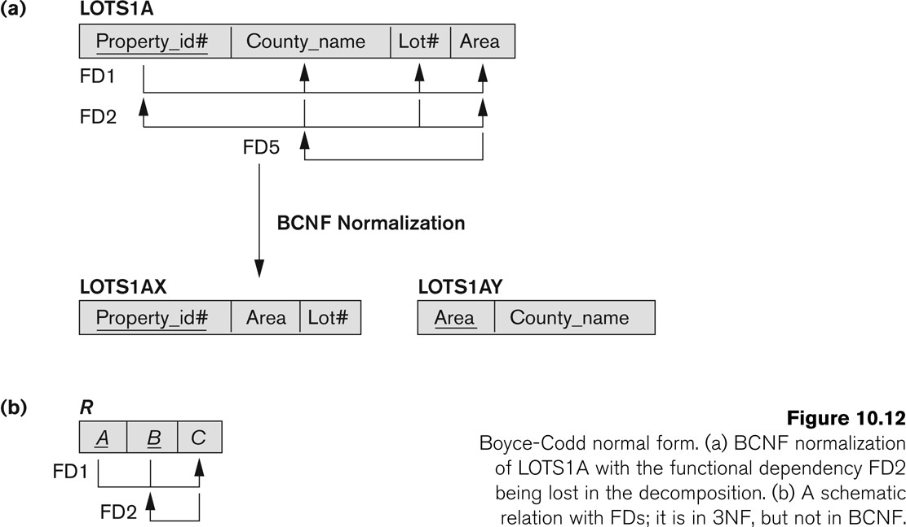
Boyce-Codd Normal form
Go, change the world
RV College of
Engineering

Slide 53
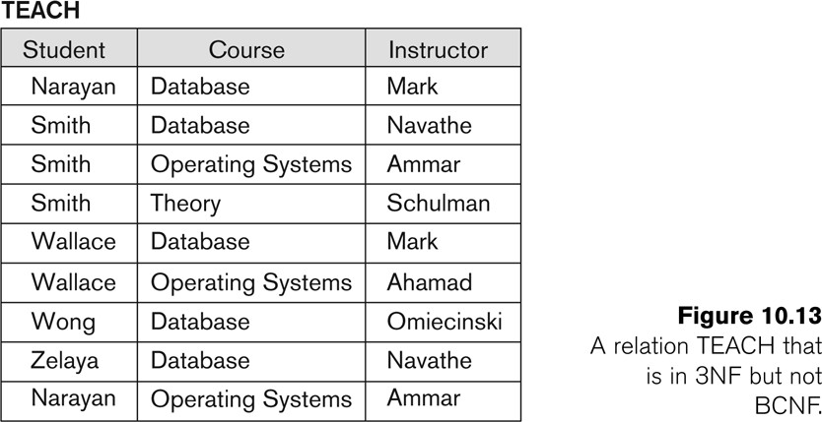
A relation TEACH that is in 3NF but not in BCNF
Go, change the world
RV College of
Engineering
Key: Student Course Student Instructor
Dependencies
Stud Course →Instructor Stud Instructor→Course Instructor→Course

Slide 54
Achieving the BCNF by Decomposition
Go, change the world
RV College of
Engineering
Three possible decompositions for relation TEACH
{student, instructor} and {student, course}
{course, instructor } and {course, student}
{instructor, course } and {instructor, student}
All three decompositions will lose FD { student, course} → instructor
We have to settle for sacrificing the functional dependency preservation. But we cannot sacrifice the non-additivity property after decomposition.
Out of the above three, only the 3rd decomposition will not generate spurious tuples after join.(and hence has the non-additivity property – to be discussed later) .

Slide 55
Go, change the world
RV College of
Engineering
Thank YOU

